Slide 1



“It’s Time” Campaign toolkit
For AP Operating Companies
DRAFT: As at 19 December 2019
© [Janssen local Operating Company]. [Company Registration No. xxx]. [Address]. [Approval number]. Date of preparation: October 2019.

Slide 2

Why “It’s Time” we did more
Foreword
Janssen is in the unique position of being able to change the trajectory of prostate cancer (PCa) in Asia Pacific and make a significant difference to the lives of thousands of men, their families and carers. We have a number of promising PCa treatments within our current portfolio and future pipeline, as well as a passionate team of people like you, who are committed to improving the standard of PCa care across the region.
It’s Time aims to challenge clinicians’ current prescribing behavior and ultimately displace combined androgen blockade (CAB) as the standard of care in advanced PCa. The campaign uses the body of evidence gained through recent phase 3 trials, in combination with thought leader testimonials, to show that CAB (or androgen deprivation therapy (ADT) alone) is not enough to delay progression to the final fatal, stage of prostate cancer (mCRPC), and highlight that patients do better when strong AR targeting agents are used first in advanced prostate cancer.
It is purposely an unbranded campaign so it can continue to evolve with our pipeline and support complementary campaigns such as “Not All Prostate Cancer Is The Same”. Most importantly, It’s Time provides an opportunity to live our Janssen Promise, by driving physician behavior to change the way advanced PCa is treated and blazing a path forward for positive change that will truly benefit patients.
We call upon you to join us by working with your customers to help transform the management of advanced prostate cancer now – It’s Time.
Kentaro Kawamura Ira Alvarez
Regional Strategic Marketing Senior Manager Commercial Lead
Asia Pacific Solid Tumours Asia Pacific Solid Tumours
Notes:
Solid Tumours Team Asia Pacific

Slide 3
It’s Time
to change the way we treat patients with advanced prostate cancer.
It’s Time
to recognize the body of evidence and put it into practice. ADT and CAB are not longer enough in the treatment of nmCRPC and mCSPC.
It’s Time
to intervene early, using a novel hormone therapy, to give your patients with nmCRPC and mCSPC more time to enjoy life with their family and friends.
It’s Time
to do more to delay the fatal stage of prostate cancer.

Slide 4

About the campaign
Key insights and strategic approach

Slide 5
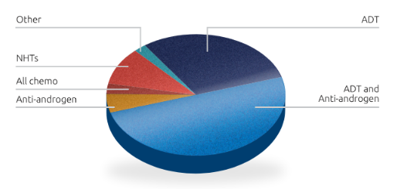
We need to challenge the status quo
By shifting reliance on outdated medicines with limited clinical benefit
Despite strong data to support novel hormone therapies like ERLEADA and ZYTIGA, the majority of clinicians in Asia Pacific currently use traditional treatments for advanced prostate cancer like mCSPC / nmCRPC.
Source: Janssen. Data on file

Slide 6

By focusing on these core elements
To instill a sense of urgency to do more for patients now
1.
2.
3.
Highlight the burden of disease post-progression
Challenge the belief there is still time
Build dissatisfaction with current treatment
QoL and likelihood of survival both drop dramatically in mCRPC
Progression happens sooner than clinicians think
CAB and ADT are no longer enough in nmCRPC and mCSPC
It’s Time
to do more to delay the fatal stage of prostate cancer

Slide 7
Introducing the materials
Core campaign resources

Slide 8
It’s time
to do more to delay the fatal stage of prostate cancer
Summary of available resources
All digital and print-ready files can be accessed via SharePoint
Core resources | Event resources | Digital
Clinician survey | Information leaflet | Banner advertisement
nmCRPC video with KOL comments | Poster / advertisement | Interactive web page (HTML5)
mCSPC video with KOL comments | PowerPoint template | Social media tiles
Design guide | Pull-up banner
Key messages / narrative
Interview questions
NB: All materials should be reviewed and approved in accordance with local market legal and regulatory requirements.

Slide 9
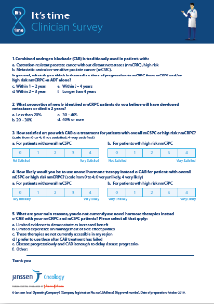
It’s time
to do more to delay the fatal stage of prostate cancer
Clinician survey
Generating local market research data
Purpose: | Determine local clinician perspectives regarding CAB and novel hormone therapies and identify knowledge gaps Understand baseline beliefs regarding CAB and novel hormone therapies and track changes over time
Description: | Short six (6) question market research survey for healthcare professionals which takes <5 mins to complete
Outcomes: | Local data to: track resonance of messages and effectiveness of campaign approach guide objection handling and address barriers to uptake of NHTs
Notes for local market use: | The most effective manner to undertake the survey in your market will depend on the channels and opportunities available to you, as well as the time and resource you have. For example, the survey can be given to clinicians in hard copy at events or hosted online (e.g. Survey Monkey) and promoted via email or other online marketing.

Slide 10
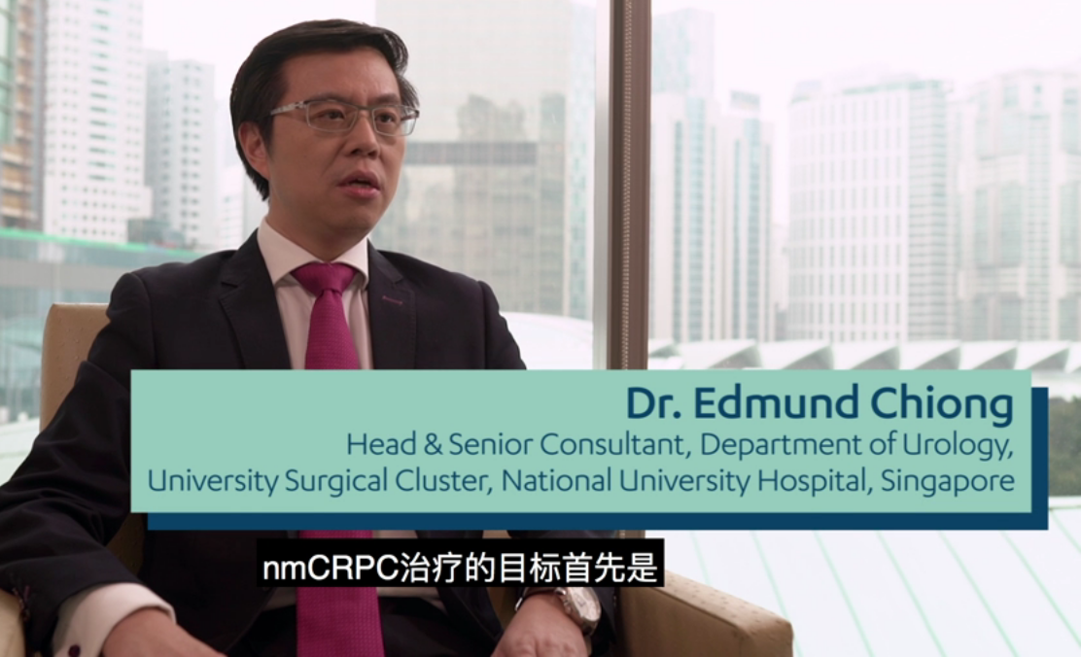
It’s time
to do more to delay the fatal stage of prostate cancer
nmCRPC video with KOL comments
Peer to peer communication
Purpose: | Highlight the body of evidence and the opinion of early adopters (KOLs) regarding the need to change management approach in nmCRPC
Description: | Combination of illustrated campaign key messages and filmed interviews with AP clinicians to communicate why they believe It’s Time to use NHTs in nmCRPC
Outcomes: | Engaging, dynamic resource to compel clinicians to use NHTs in nmCRPC instead of CAB or ADT
Notes for local market use: | Copy translation document available to facilitate local use including additional of local language subtitles Source files available to support editing locally including addition of local KOLs where available

Slide 11
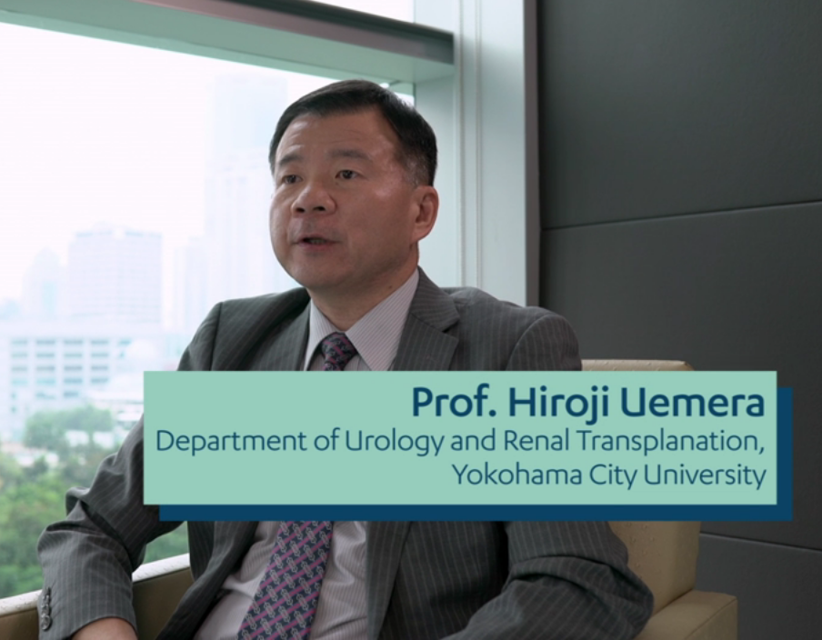
It’s time
to do more to delay the fatal stage of prostate cancer
mCSPC video with KOL comments
Peer to peer communication
Purpose: | Highlight the body of evidence and the opinion of early adopters (KOLs) regarding the need to change management approach in mCSPC
Description: | Combination of illustrated campaign key messages and filmed interviews with AP clinicians to communicate why they believe It’s Time to use NHTs in mCSPC
Outcomes: | Engaging, dynamic resource to compel clinicians to use NHTs in mCSPC instead of CAB or ADT
Notes for local market use: | Copy translation document available to facilitate local use including additional of local language subtitles Source files available to support editing locally including addition of local KOLs where available

Slide 12
It’s time
to do more to delay the fatal stage of prostate cancer
Design Guide
Key information to support campaign resource production
Purpose: | Enable local campaign resources to be produced quickly and easily
Description: | Covers campaign logos, colours palette, fonts and examples of applications
Outcomes: | All locally produced materials visually align with existing resources to maintain consistency across region and build resonance
Notes for local market use: | Provides an outline of available digital and print resources to support local market use and customisation Includes both PC and Mac versions

Slide 13
It’s time
to do more to delay the fatal stage of prostate cancer
Campaign narrative
Key messages underpinning campaign resources
Purpose: | Enable local campaign resources to be produced quickly and easily
Description: | Core campaign key messages and references
Outcomes: | Provides a foundation for the development of subsequent messages and materials
Notes for local market use: | Can be used to test campaign key messages to ensure compliance with local market legal and regulatory requirements before progressing specific materials through review Can also be used to support the development of additional resources such as direct marketing communications to healthcare professionals to support the campaign.

Slide 14
It’s time
to do more to delay the fatal stage of prostate cancer
Information leaflet
Purpose: | Core campaign printed collateral to leave with customers
Description: | Double-sided A5 information brochure covering core campaign key messages
Outcomes: | Support campaign call to action and encourage discussion regarding the role of NHTs during customer engagement at events and during one-to-ones / small meetings
Notes for local market use: | Opportunity to tailor this resource by including local KOL commentary and / or patient case studies Can also be repurposed as a leave behind for medical representatives by including contact details and links to additional local information resources such as Janssen Pro

Slide 15
It’s time
to do more to delay the fatal stage of prostate cancer
Poster / advertisement
Purpose: | For use in relevant healthcare professional publications, congress booklets or event materials
Description: | A4 sized campaign advertisement
Outcomes: | Capture audience attention and increase campaign reach and resonance via relevant communication channels in conjunction with broader campaign activities
Notes for local market use: | Can be easily repurposed to suit a range of production sizes

Slide 16


It’s time
to do more to delay the fatal stage of prostate cancer
PowerPoint template
Purpose: | Support any communication in relation to the campaign with internal and external audiences
Description: | PowerPoint template with key campaign colours, fonts and logos
Outcomes: | All locally produced materials visually align with existing resources
Notes for local market use: | English and Simplified Chinese templates available for local customisation. For other languages, the template will need to be updated with the translated version of the campaign logo and call to action.

Slide 17
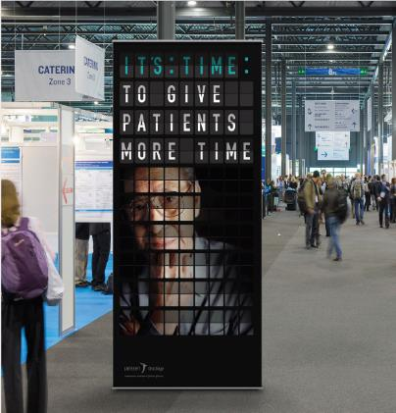

It’s time
to do more to delay the fatal stage of prostate cancer
Pull-up banner
Purpose: | Re-usable and easily transportable campaign material
Description: | Designed for use as a free-standing pull-up banner for use during events, on exhibition stands, in symposium room and/or at entrances or on stage Can be re-used for regional and local meetings and/or other relevant customer events
Outcomes: | All locally produced materials visually align with existing resources to maintain consistency across region and build resonance
Notes for local market use: | Design-files may need to be resize to fit existing pull-up banner cartridge

Slide 18

It’s time
to do more to delay the fatal stage of prostate cancer
Banner advertisement
Purpose: | Provide a core visual resource for online use
Description: | Online banner advertisement
Outcomes: | Support broader campaign activities and link to online information (where available)
Notes for local market use: | Can be easily resized to suit target website requirements Where online resources are not possible to link to, the ‘Learn more’ button can be removed

Slide 19

It’s time
to do more to delay the fatal stage of prostate cancer
Interactive web page
Purpose: | Provide an engaging and dynamic communication platform for core campaign content including KOL and patient videos as well as additional educational resources
Description: | HTML 5 web page with animated elements
Outcomes: | Enduring campaign resources easily accessible for customers, potential to track campaign engagement and message resonance
Notes for local market use: | Consideration should be given to where this resource could be hosted e.g. JanssenPro and any technical / resource constraints Whilst some investment may be required to incorporate this interactive web page into existing resources, it provides a digital resource that can continue to be updated as further campaign resources are developed Where possible, consider opportunities to track customer engagement and usage of resources to guide future activities

Slide 20

It’s time
to do more to delay the fatal stage of prostate cancer
Social media tiles
Purpose: | Extend campaign visuals and key messages into relevant social media channels to support omnichannel approach
Description: | Imagery for use on social media in alignment with campaign visuals and key messages
Outcomes: | Extend campaign reach and resonance and encourage broader engagement
Notes for local market use: | Can be easily resized to suit target social channel image requirements to, the ‘Learn more’ button can be removed

Slide 21
Local implementation
Considerations and recommendations

Slide 22
It’s time
to do more to delay the fatal stage of prostate cancer
Considerations for localizing the campaign
Key Opinion Leader (KOL) engagement
Do you have local KOLs that you may be able to involve in the campaign?
You may wish to consider interviewing and/or filming them to create your own content to supplement the core resources.
Video content can be utilized during relevant meetings (National, local), sponsored symposia and on exhibition stands. Quotes or testimonials from KOLs (where allowed under local regulations) can be incorporated into print materials, added to website copy, included in MSL / field force customer conversation resources and added to direct marketing communications e.g. EDMs.
A core set of interview questions is available to support you.
  You

Slide 23
It’s time
to do more to delay the fatal stage of prostate cancer
Considerations for localizing the campaign
Patient case studies
Could you work with your KOLs to identify patients and/or carers who would be willing to talk about their experience with prostate cancer?
It is recommended that you identify patients (or carers) with advanced prostate cancer. The type of questions they would be asked include their experience of living with metastatic disease, their treatment pathway and how their quality of life has changed with disease stages.
The focus of any patient case studies would be to highlight the physiological and psychological burden of progressing to advanced stages, as a means to reinforce with customers the importance of intervening early to delay this final, fatal stage of prostate cancer.
A core set of interview questions is available to support you.

Slide 24
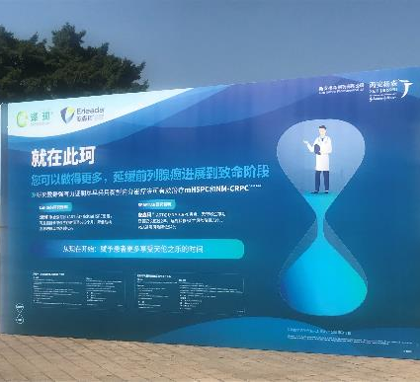
It’s time
to do more to delay the fatal stage of prostate cancer
Considerations for localizing the campaign
Embedding the campaign into planned activities
Do you have existing events or promotional activities that you could utilize to implement the campaign?
The campaign resources can be used in conjunction with any brand activities or events that you may have already planned. This may include National Conferences, regional meetings or local city events. For example, the China team launched It’s Time at the 2019 Chinese Urology Association Conference with a strong visual presence including billboards, exhibition stand displays, banners. They also utilized the information leaflet and clinician survey.

