Slide 1
62-year-old man with metastatic castration sensitive prostate cancer
HOME
CASE HISTORY
EVIDENCE
CONCLUSION
API
Using PSMA-PET for accurate staging in biochemical recurrent metastatic prostate cancer
Photo by Hobi industri on Unsplash
PET, positron emission tomography; PSMA, Prostate-specific membrane antigen

Slide 2
Disclaimer
These case studies include information about Janssen products, some of which may not be approved for the treatment of patients in Asia Pacific.
Any such data shared in this case study is for obtaining feedback, and/or for educational purposes and should not be interpreted as intent to promote unapproved uses.
Janssen prohibits the promotion of unapproved uses in any fashion and complies with all applicable laws, regulations, and company policies.
Please refer to the relevant SmPC of any compounds mentioned in this case study for full prescribing information. As prescribing information may vary from country to country, please refer to your local prescribing information for complete details.

Slide 3
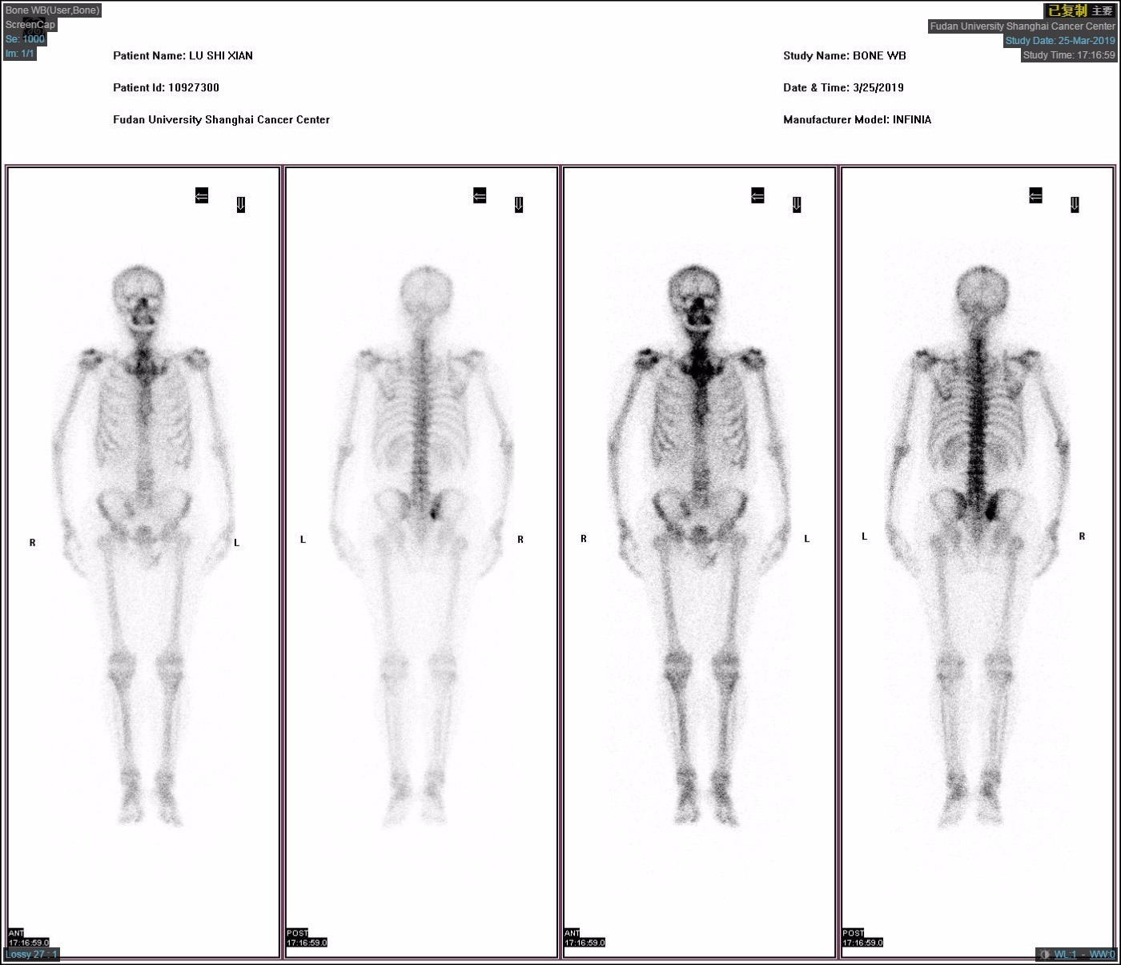
CLINICAL PRESENTATION
Case courtesy of Associate Professor Yao ZHU, Fudan University, Shanghai Cancer Center
62-year-old man with prostate cancer presents with rising PSA two years after radical prostatectomy
Photo by Hobi industri on Unsplash
ECT scan (March 2010): Negative
PSA level (March 2019): Increased to 0.23 ng/ml
ECT, Electroconvulsive therapy PSA, prostate-specific antigen

Slide 4
MEDICAL AND TREATMENT HISTORY
PSA level: 7.33 ng/ml
Gleason scores
- 9(5+4) in
10/12 biopsies
- 8(4+4) in 2/12
biopsies
Radical prostatectomy (surgery was performed uneventfully)
PSA level: 0.04 ng/ml
- Prostate
adenocarcinoma
plus intraductal
carcinoma
- Gleason score: 5+4
- pT3aN0
- Negative surgical
margin
Regular PSA tests every 3 months (without adjuvant treatment)
Case courtesy of Associate Professor Yao ZHU, Fudan University, Shanghai Cancer Center
APRIL 2017
(INITIAL DIAGNOSIS)
AUGUST 2017 (INTERVENTION)
AUGUST 2017 (POSTOPERATIVE PATHOLOGY)
OCTOBER 2017
(FIRST POSTOPERATIVE FOLLOW-UP)
PSA, prostate-specific antigen

Slide 5
PSMA-PET is recommended for accurate staging in biochemical recurrent prostate cancer^{1,2}
PSMA-PET recommendations for biochemical recurrent prostate cancer²
After radical prostatectomy if PSA level is > 0.2 ng/mL and results will influence subsequent treatment decisions
After radiotherapy if patients are fit for curative salvage treatment
PSMA-PET is as or more sensitive and specific in detecting micrometastatic disease than conventional imaging tools for patients with biochemical recurrence^{1,2} -NCCN & EAU guidelines
EAU, European Association of Urology; NCCN, National Comprehensive Cancer Network; PET, positron emission tomography; PSA, prostate-specific antigen; PSMA, Prostate-specific membrane antigen

Slide 6
PSMA PET/CT TEST RESULTS (APRIL 2019)
Case courtesy of Associate Professor Yao ZHU, Fudan University, Shanghai Cancer Center
1 positive lesion on the T2 thoracic vertebra
1 positive lesion on the sacrum
CT, computed tomography PET, positron emission tomography; PSMA, prostate-specific membrane antigen

Slide 7
INTERVENTION
Which of the following treatment options would you offer this patient?
Radiotherapy to primary site
ADT + radiotherapy to PSMA-positive metastases
ADT + NHT (eg, ABI, ENZA, APA) + radiotherapy to PSMA-positive metastases
ADT only
ADT + NHT
Other
ABI, abiraterone; ADT, androgen-deprivation therapy; APA, apalutamide; ENZA, enzalutamide; NHT, novel hormonal therapy; PSMA, Prostate-specific membrane antigen

Slide 8
INTERVENTION AND OUTCOMES
Case courtesy of Associate Professor Yao ZHU, Fudan University, Shanghai Cancer Center
Treatments received
ADT + APA
SBRT to metastatic sites according to PSMA-PET
PSA decreased to < 0.05 ng/ml at 3 months
PSMA-PET reported no significant PSMA uptake
Patient had mild hot flash
No significant AE was reported
AE, adverse event; ADT, androgen-deprivation therapy; APA, apalutamide; PET, positron emission tomography; PSMA, Prostate-specific membrane antigen; SBRT, stereotactic body radiation therapy

Slide 9
PSMA-PET FOR ACCURATE STAGING AND TREATMENTS FOR MCSPC
PSMA-PET is recommended for accurate staging in biochemical recurrent prostate cancer
APA plus ADT improved survival outcomes in mCSPC
Radio-ablation of metastatic disease in oligometastases prostate cancer increased disease progression-free rate

Slide 10
APA plus ADT improved survival outcomes in mCSPC
33% lower risk of death with APA
HR for radiographic progression or death: | 0.48 (95% CI, 0.39 to 0.60); P<0.001
HR for death: | 0.67 (95% CI, 0.51 to 0.89); P = 0.005
Median of 22.7 months of follow-up
TITAN: In this double-blind, phase III trial, 525 patients with mCSPC were randomly assigned to receive APA (240 mg per day) plus ADT or placebo plus ADT
Median age was 68 years
16.4% underwent prostatectomy or received radiotherapy for localized disease
ADT, androgen-deprivation therapy; APA, apalutamide; CI, confidence interval; HR, hazard ratio; mCSPC, metastatic castration sensitive prostate cancer; OS, overall survival; rPFS, radiographic progression–free survival

Slide 11
Radio-ablation of metastatic disease in oligometastases prostate cancer increased disease progression-free rate
Stereotactic ablative radiotherapy improved median PFS (HR, 0.30 (95%CI, 0.11-0.81); P = 0.002
Median PFS
Stereotactic ablative radiotherapy: | Not reached
Observation : | 5.8 months
ORIOLE: In this phase 2, randomized study, 54 patients with recurrent hormone-sensitive prostate cancer were randomized in a 2:1 ratio to receive stereotactic ablative radiotherapy or observation
Median age was 68 years
PFS, progression-free survival

Slide 12
Case courtesy of Associate Professor Yao ZHU, Fudan University, Shanghai Cancer Center
CONCLUSION
Based on the evidence, the patient received regional as well as systemic treatment
TITAN: Adding apalutamide to androgen deprivation therapy in metastatic castration sensitive prostate cancer improved survival outcomes¹
ORIOLE: Radio-ablation of metastatic disease in oligometastases prostate cancer increased progression-free rate²
The patient’s short-term outcome was good
Photo by Hobi industri on Unsplash
1. Chi KN, et al. N Engl J Med 2019;381(1):13-24. 2. Phillips R, et al. JAMA Oncol. 2020;6(5):650-659.

