Slide 1
72-year-old man with high volume metastatic hormone-sensitive prostate cancer
HOME
CASE HISTORY
EVIDENCE
CONCLUSION
API
Using PSMA-PET to detect high volume metastatic prostate cancer
Photo by Nicate Lee on Unsplash

Slide 2
Disclaimer
These case studies include information about Janssen products, some of which may not be approved for the treatment of patients in Asia Pacific.
Any such data shared in this case study is for obtaining feedback, and/or for educational purposes and should not be interpreted as intent to promote unapproved uses.
Janssen prohibits the promotion of unapproved uses in any fashion and complies with all applicable laws, regulations, and company policies.
Please refer to the relevant SmPC of any compounds mentioned in this case study for full prescribing information. As prescribing information may vary from country to country, please refer to your local prescribing information for complete details.

Slide 3
CLINICAL PRESENTATION
Case courtesy of Associate Professor Melvin LK CHUA, National Cancer Centre Singapore
72-year-old man with prostate cancer presents with several sclerotic bone lesions after a routine CT TAP scan (no comorbidities)
Photo by Nicate Lee on Unsplash
Investigations
¹⁸F-FDG PET-CT scan (Jul 2021) – done as surveillance imaging for rectal cancer treated surgically 4 years ago: 3 pelvic bone lesions suspicious of metastatic lesions; no definite primary
PSA level (Jul 2021) 109
MRI Pelvis (Jul 2021): Large prostate primary; Multiple pelvic bone lesions – sacrum, acetabulum
⁶⁸Ga-PSMA PET-CT scan (Aug 2021): Tracer-avid bony mets in the T1 vertebra and multiple pelvic sites; 8 in total
Biopsy of the prostate not feasible due to previous APR
To treat as low or high Low or High volume mCSPC?
APR, abdominoperineal resection; CT TAP, computed tomography of thorax, abdomen and pelvis; FDG, fluorodeoxyglycose; mCSPC, metastatic castration sensitive prostate cancer; met, metastasis; PET, positron emission tomography; PSMA, prostate-specific membrane antigen

Slide 4
PSMA-PET is recommended for accurate staging in biochemical recurrent prostate cancer^{1,2}
PSMA-PET recommendations for biochemical recurrent prostate cancer²
After radical prostatectomy if PSA level is > 0.2 ng/mL and results will influence subsequent treatment decisions
After radiotherapy if patients are fit for curative salvage treatment
PSMA-PET is as or more sensitive and specific in detecting micrometastatic disease than conventional imaging tools for patients with biochemical recurrence^{1,2} -NCCN & EAU guidelines
EAU, European Association of Urology; NCCN, National Comprehensive Cancer Network; PET, positron emission tomography; PSA, prostate-specific antigen; PSMA, Prostate-specific membrane antigen

Slide 5
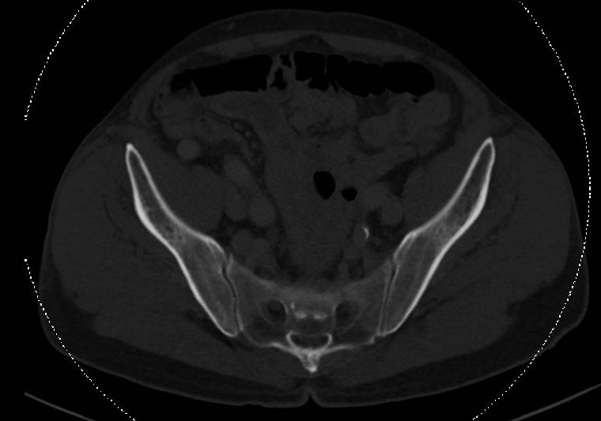
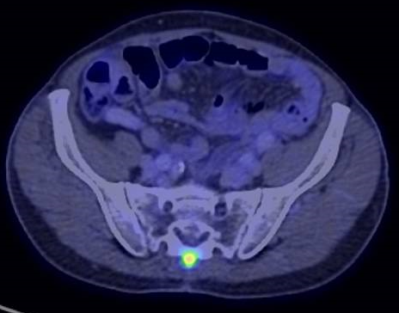
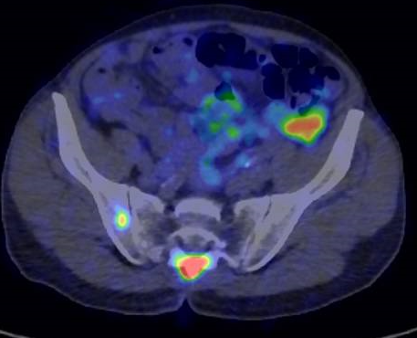
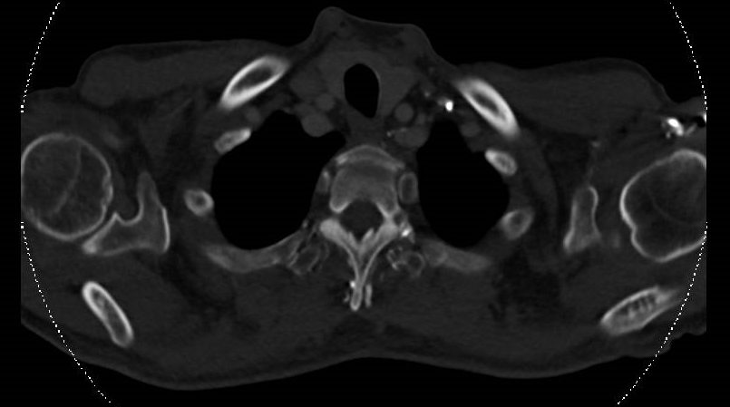
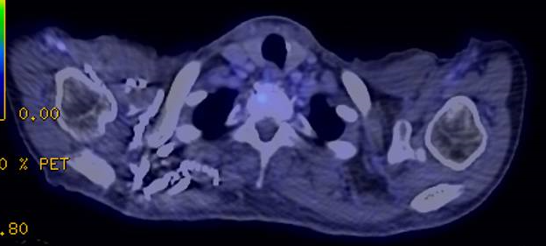
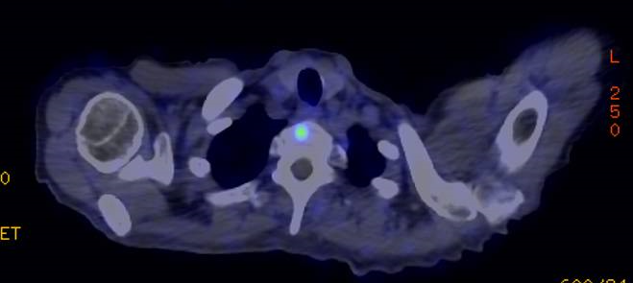
Low volume to High volume mCSPC following NGI
Case courtesy of Associate Professor Melvin LK CHUA, National Cancer Centre Singapore
CT TAP
¹⁸F-FDG-PET
⁶⁸Ga-PSMA-PET
Sacrum
T1 vertebra
FDG, fluorodeoxyglycose; mCSPC, metastatic castration sensitive prostate cancer; PET, positron emission tomography; PSMA, prostate-specific membrane antigen

Slide 6
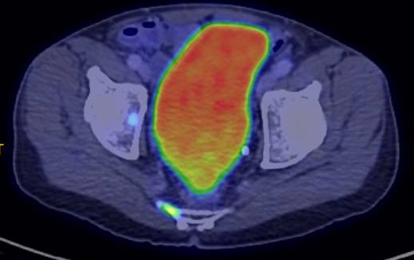
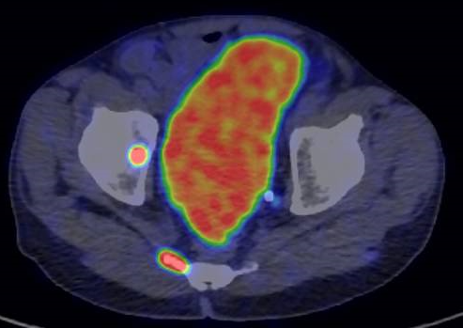
Concordance between ¹⁸F-FDG & ⁶⁸Ga-PSMA in hormone-sensitive PCa
Case courtesy of Associate Professor Melvin LK CHUA, National Cancer Centre Singapore
Metastases
Acetabulum
Sacrum
T1 vertebra
¹⁸F-FDG
⁶⁸Ga-PSMA
FDG, fluorodeoxyglycose; PCa, prostate cancer; PSMA, prostate-specific membrane antigen

Slide 7
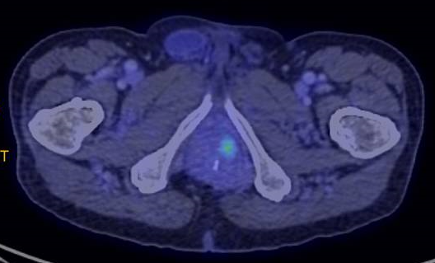
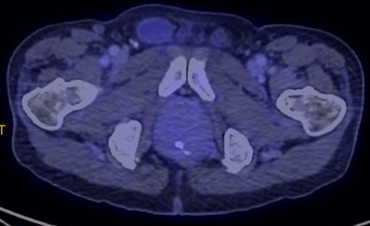
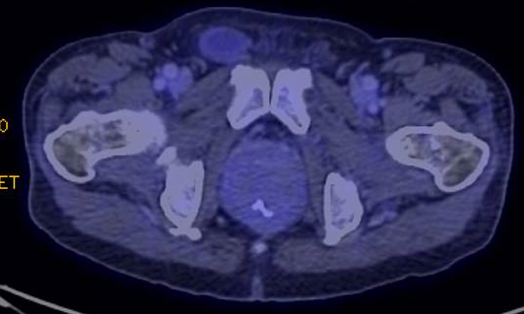
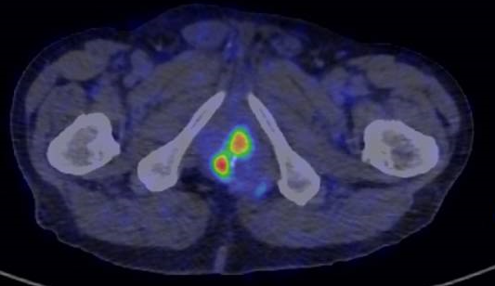
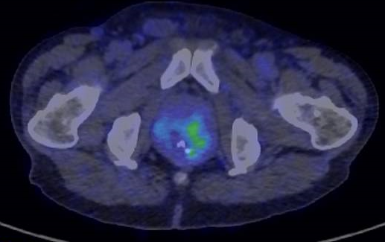
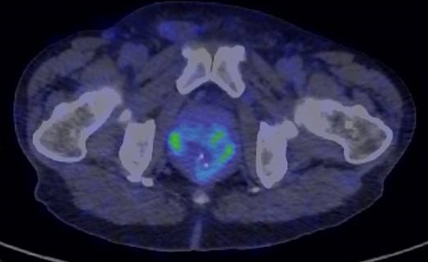
Concordance between ¹⁸F-FDG & ⁶⁸Ga-PSMA in hormone-sensitive PCa
Case courtesy of Associate Professor Melvin LK CHUA, National Cancer Centre Singapore
Primary tumour
¹⁸F-FDG
⁶⁸Ga-PSMA
FDG, fluorodeoxyglycose; PCa, prostate cancer; PSMA, prostate-specific membrane antigen

Slide 8
INTERVENTION
Which of the following treatment options would you offer this patient?
ADT only
ADT +
Chemotherapy
ADT +
NHT
ADT +
NHT +
Chemotherapy
ADT +
RT to Prostate
ADT +
NHT +
RT to Prostate
ABI, abiraterone; ADT, androgen-deprivation therapy; APA, apalutamide; ENZA, enzalutamide; NHT, novel hormonal therapy; PSMA, Prostate-specific membrane antigen

Slide 9
INTERVENTION AND OUTCOMES
Case courtesy of Associate Professor Melvin LK CHUA, National Cancer Centre Singapore
Treatments received
ADT (degarelix) + apalutamide
Good response to APA → to continue treatment
PSA drop from 109 → 0.07 after 3 mo of APA
Radiotherapy to the primary tumour??
ADT, androgen-deprivation therapy; APA, apalutamide.

Slide 10
PSMA-PET AND RADIOTHERAPY IN HIGH VOLUME METASTATIC PROSTATE CANCER
PSMA-PET is recommended for accurate staging in biochemical recurrent prostate cancer
Radiotherapy to primary tumour

Slide 11
Radiotherapy to primary tumour??
Original publication: SOC vs SOC + RT to primary tumour
SOC is ADT +/- Docetaxel (20%)
Overall cohort – no difference
When stratified by CHAARTED volume criteria, no benefit with high-volume, but FFS benefit with low-volume (HR 0.76)
STOPCAP meta-analysis (+HORRAD): 7% benefit for 3y OS for those with ≤5 mets
Systemic evaluation of metastatic burden on benefits of local RT
ADT, androgen-deprivation therapy; FFS, failure-free survival; HR, hazard ratio; met, metastasis; RT, radiotherapy; OS, overall survival; SOC, standard of care

Slide 12
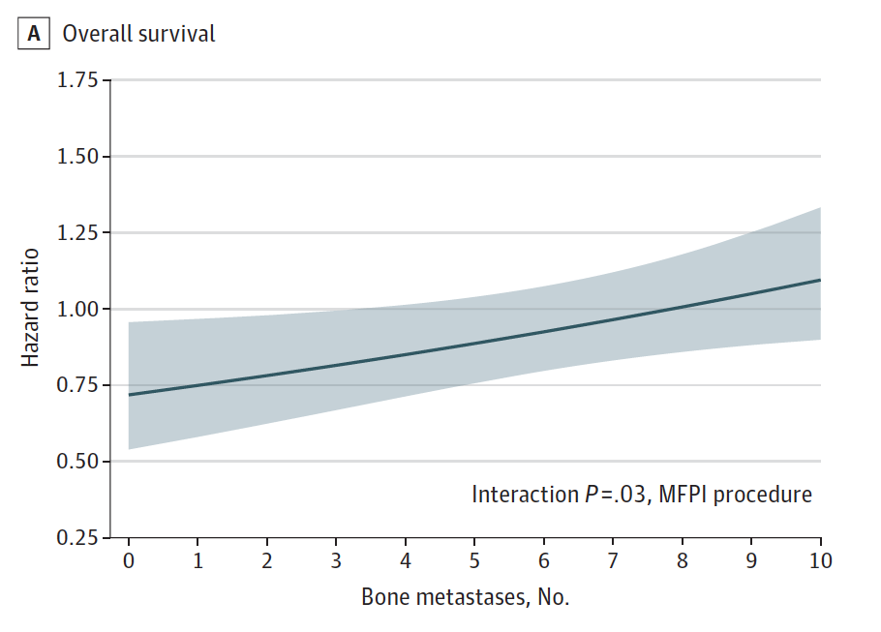
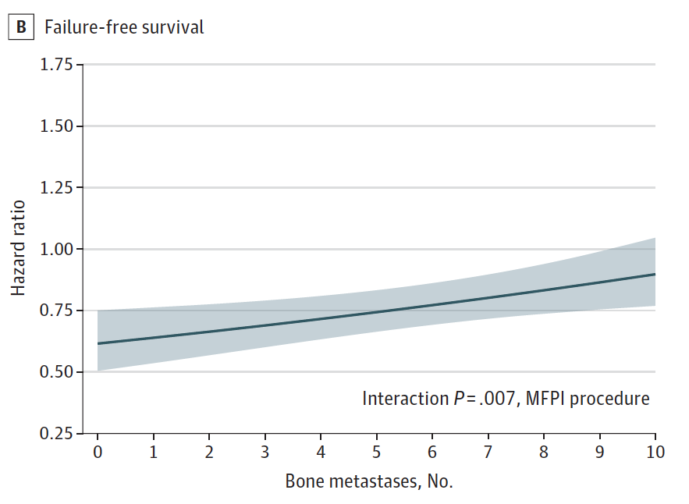
Radiotherapy to primary tumour??
Overall survival
Failure-free survival

Slide 13
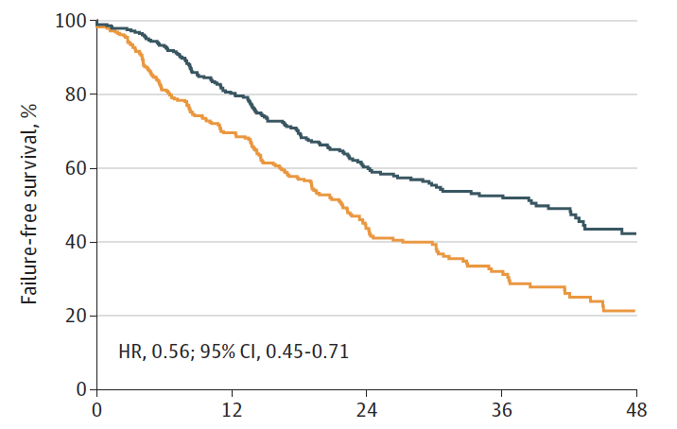
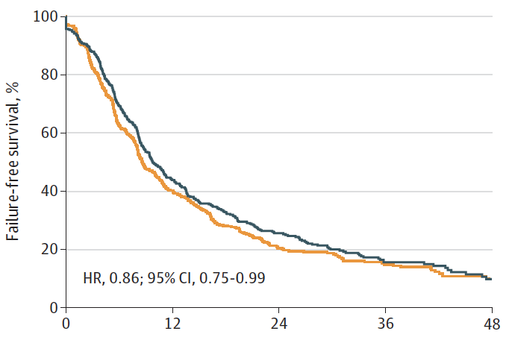
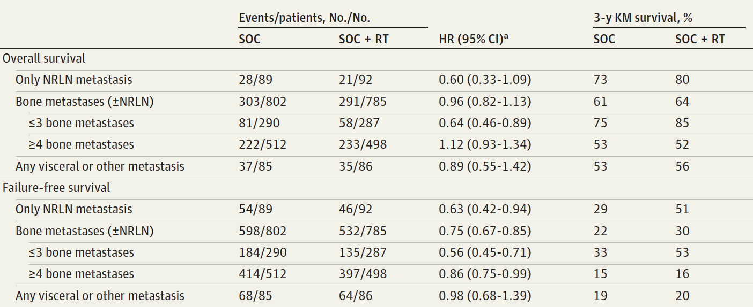
Radiotherapy to primary tumour??
≤3 bone mets +/- RPLN
≥4 bone mets +/- RPLN

Slide 14
CONCLUSION
Case courtesy of Associate Professor Melvin LK CHUA, National Cancer Centre Singapore
Next-generation imaging (⁶⁸Ga-PSMA) detected more lesions and was able to identify high volume mCSPC compared to conventional imaging (¹⁸F-FDG)
Patient demonstrated good response to APA and drop in PSA levels from 109 to 0.07 after 3 months
Despite his advanced age, patient tolerated full dose APA. He developed G1 skin rash that was managed by topical steroids and emollients.
Based on the evidence,
Bone metastasis count and metastasis location demonstrated OS and FFS benefit from prostate RT in M1 disease¹
Photo by Nicate Lee on Unsplash
FDG, fluorodeoxyglycose; FFS, failure-free survival; mCSPC, metastatic castration sensitive prostate cancer; RT, radiotherapy; OS, overall survival; PSMA, prostate-specific membrane antigen
1. Ali A, et al. JAMA Oncol 2021;7(4):555-563.

