Slide 1
60-year-old man with low-risk metastatic castration sensitive prostate cancer
HOME
CASE HISTORY
EVIDENCE
CONCLUSION
API
Managing apalutamide-associated skin rash AE
Photo by Alief Priyanto on Unsplash

Slide 2
Disclaimer
These case studies include information about Janssen products, some of which may not be approved for the treatment of patients in Asia Pacific.
Any such data shared in this case study is for obtaining feedback, and/or for educational purposes and should not be interpreted as intent to promote unapproved uses.
Janssen prohibits the promotion of unapproved uses in any fashion and complies with all applicable laws, regulations, and company policies.
Please refer to the relevant SmPC of any compounds mentioned in this case study for full prescribing information. As prescribing information may vary from country to country, please refer to your local prescribing information for complete details.

Slide 3
CLINICAL PRESENTATION
Case courtesy of Dr Kohei HASHIMOTO, Sapporo Medical University School of Medicine
60-year-old man with low-risk metastatic castration sensitive prostate cancer
Photo by Alief Priyanto on Unsplash
Age: 60
T2aN0M0
iPSA 10.13 ng/ml
Gleason score 5+4
Adenocarcinoma
IMRT 78Gy+ADT
PSA 2.85
Multiple bone metastasis
PSA
recurrence
Low risk mCSPC
GS5+4
Bone metastasis:2
ADT, androgen deprivation therapy; GS, Gleason score; IMRT, intensity-modulated radiotherapy; mCSPC, metastatic castration sensitive prostate cancer; PSA, prostate specific antigen.

Slide 4
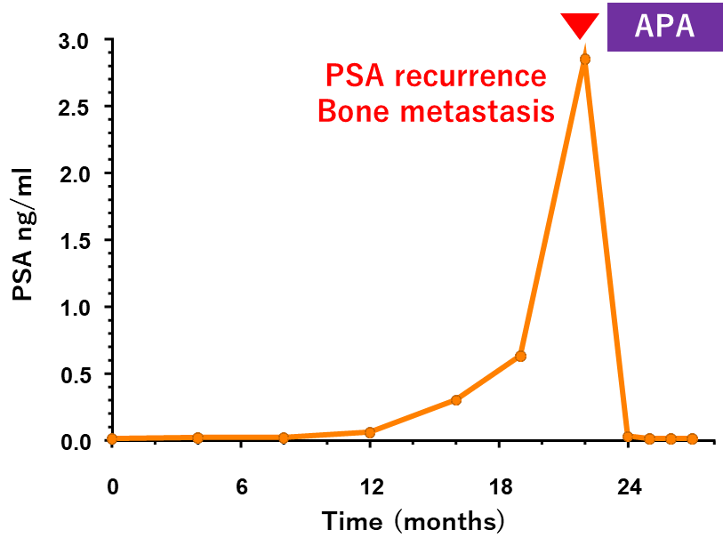
PsA levels following apalutamide
Case courtesy of Dr Kohei HASHIMOTO, Sapporo Medical University School of Medicine
Age: 60
T2aN0M0
iPSA 10.13 ng/ml
Gleason score 5+4
Adenocarcinoma
IMRT 78Gy+ADT
PSA 2.85
Multiple bone metastasis
PSA
recurrence
ADT, androgen deprivation therapy; APA, apalutamide; IMRT, intensity-modulated radiotherapy; mCSPC, metastatic castration sensitive prostate cancer; PSA, prostate specific antigen.

Slide 5
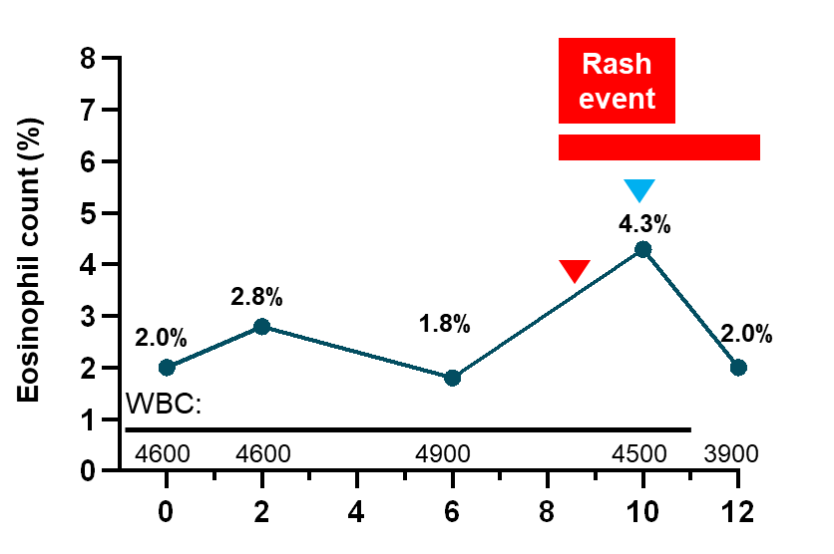
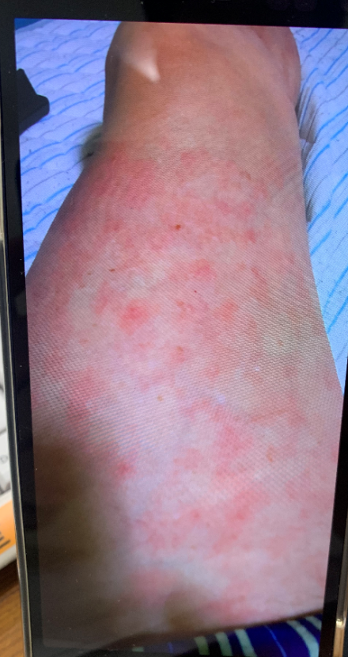
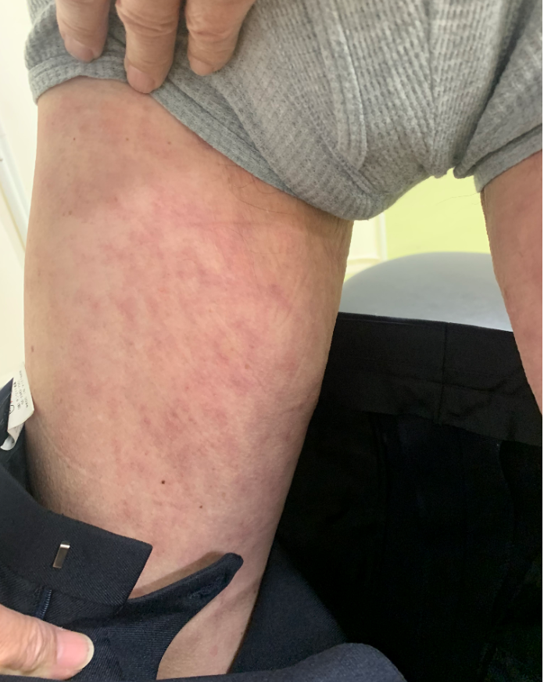
Apalutamide-associated skin rash
Case courtesy of Dr Kohei HASHIMOTO, Sapporo Medical University School of Medicine
Age: 60
T2aN0M0
iPSA 10.13 ng/ml
Gleason score 5+4
Adenocarcinoma
IMRT 78Gy+ADT
PSA 2.85
Multiple bone metastasis
PSA
recurrence
ADT + apalutamide
240mg
180mg
Levocetirizine 5mg
(a second-generation antihistamine)
Wheal-like, papular rash Grade2
24 days
ADT, androgen deprivation therapy; IMRT, intensity-modulated radiotherapy; mCSPC, metastatic castration sensitive prostate cancer; PSA, prostate specific antigen.

Slide 6
MANAGING APALUTAMIDE-ASSOCIATED SKIN RASH AE
TITAN: Safety profile of APA plus ADT
Skin rash following administration of APA in Japanese patients
Relationship between rash and plasma exposure to APA

Slide 7
TITAN study: Adverse events
ADT, androgen deprivation therapy; APA, apalutamide; TEAE, treatment-emergent adverse event; PBO, placebo.

Slide 8
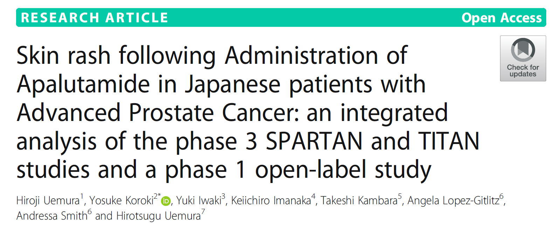
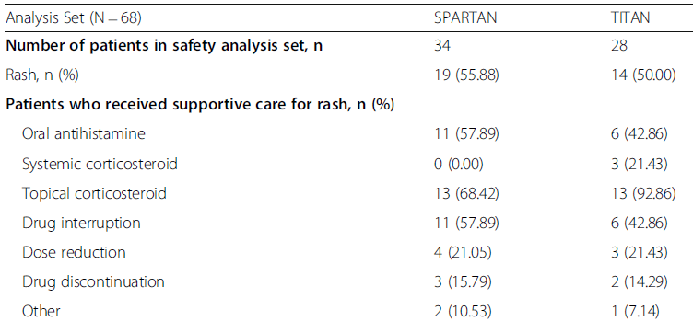
Japanese patients: Adverse events
Management of rash
1.0 month (IQR: 0.36–1.81)
types of rash in Apalutamide-treated
IQR, interquartile range.
Uemura et al. BMC Urology 2020

Slide 9
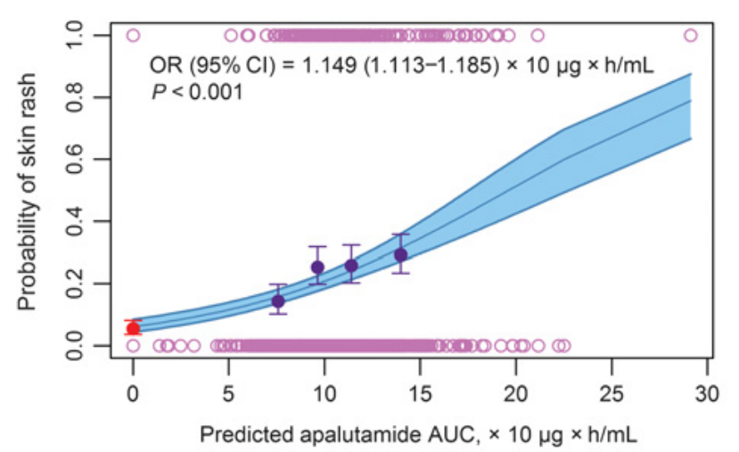
Relationship between incidence of rash and plasma exposure (AUC0-24) to apalutamide
(Uemura et al. 2020)¹
(Perez-Ruixo C 2021)²
AUC, area under curve; CI, confidence interval; OR, odds ratio.

Slide 10
Case courtesy of Dr Kohei HASHIMOTO, Sapporo Medical University School of Medicine
CONCLUSION
The incidence of apalutamide-related skin rash was higher in Japanese patients compared to patients from the rest of the world
Clinicians should look out for skin rashes as patients often do not self report
There is a potential correlation between incidence of skin rash and plasma exposure to apalutamide
Eosinophil levels may be an important indication of whether patients will develop skin rashes
Management:
Dose reductions/interruptions
Treatment with oral antihistamines and topical/systemic corticosteroids led to resolution of the majority of skin rashes observed in Japanese patients within 30 days
Photo by Alief Priyanto on Unsplash

