Slide 1
Low-risk/low-volume mCSPC

Slide 2
Case details and discussion plan
Patient detailing
A case of 65-year-old healthy and active male patient with mCSPC was discussed. Patient had low Gleason score and a single bone metastasis, hydronephrosis, and incomplete bladder emptying. First symptoms started in January 2020 with fatigue and shoulder pain.
Co-morbidity: Hypertension
DRE: Hard mass, cT4
PSA: 67.4 ng/mL
Bone metastases: 1 vertebral
Biopsy results: Gleason score 3 + 4 = 7, no signs of any other cancer
Discussion: How would you treat this patient?
ADT + docetaxel
OR
ADT + Apalutamide or Enzalutamide
OR
ADT monotherapy
OR
ADT + RT to primary tumor
OR
ADT + RT + Apalutamide or Enzalutamide or Abiraterone
ADT: androgen-deprivation therapy; DRE: digital rectal exam; mCSPC: metastatic castrate-sensitive prostate cancer; PSA: prostate-specific antigen; RT: radiation therapy

Slide 3
Panelist insights
Experts shared regional insights about rational management of this case and choice of treatment for such patients.
The patient should be seen in MDT clinic and must participate in therapy discussions.
In this case, the weightage is more towards quality of life.
A combination of ADT + oral agent would be preferable.
Chemotherapy as an oral agent is not ideal for this patient and is a better fit for high-volume disease.
RT + combined systemic therapy to treat the primary tumor can also be considered.
The panelists agreed that:
Treatment intensification improves overall survival also in low-risk/low-volume mCSPC.
Approach of the treatment should be multi-disciplinary and decision-making is rested with patient collaboration.
TITAN, ARCHES, ENZAMET trials showed benefit in overall survival in patients on ADT + oral agent.
RT + combined systemic therapy is another option to treat the primary tumor, as per STAMPEDE trial.
ADT + prostate radiation can be advocated if the patient can tolerate.
A/Prof. Lee Lui Shiong
In agreement with A/Prof Lee’s suggestion, at least radiation therapy can be considered for this patient.
For patients who are not inclined to radiation, but still wish to have the primary lesions treated occasionally, such patients can be considered for surgery.
Dr. Loh Chit Sin
Preference would be to start with a hormonal treatment + oral agents, as its effects in terms of OS is more profound than ADT + RT to prostate alone, possibly followed by radiation therapy to prostate later.
ADT + oral agent (APA or ENZA) which will be beneficial based on TITAN, ENZAMET and ARCHES studies, even though it is a low volume disease.
ADT + prostate radiation can be advocated if the patient can tolerate.
A/Prof. Edmund Chiong
A/Prof: Associate Professor; ADT: androgen-deprivation therapy; APA: Apalutamide; Enza: Enzalutamide; mCSPC: metastatic castrate-sensitive prostate cancer; MDT: multidisciplinary team; OS: overall survival; RT: radiation therapy

Slide 4
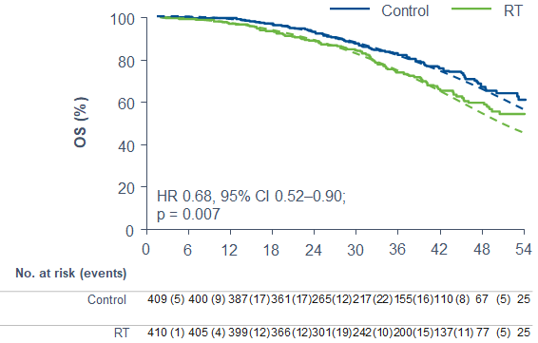
Clinical insights
Apalutamide showed OS benefits in both low-volume and high-volume disease patients, as evident from TITAN study.
Similar OS benefit was shown by enzalutamide in ARCHES trial sub-group analysis, regardless of tumor volume.
In STAMPEDE study, standard of care + radiation therapy to primary tumor revealed OS benefits only in patients with low-burden disease.
Trials/ Parameters | STAMPEDE¹ | ARCHES² | TITAN³
Intervention | ADT + Doc/RT | ADT + Enza | ADT + Apa
Comparator | ADT | ADT + PBO | ADT + PBO
OS
Low-metastatic burden disease¹
meaning better
Parker C, et al. Lancet. 2018;392:2353-66. 2. Andrew J. Armstrong, presented at ESMO 2021; LBA25. 3. Chi, KN. et al. ASCO-GU 2021. Oral Presentation #11
Abi: Abiraterone; ADT: androgen-deprivation therapy; Apa: Apalutamide; Doc: Docetaxel; Enza: Enzalutamide; Expo: exponential; OS: overall survival; PBO: placebo; RT: radiotherapy

Slide 5
Discussion and Conclusion
Treatment intensification improves overall survival also in low-risk/low-volume mCSPC.
TITAN, ARCHES, ENZAMET trials showed benefit in overall survival in patients on ADT + oral agent.
ADT + prostate radiation can be considered if the patient can tolerate. If not radiation therapy, then primary lesions can be removed surgically (but high-level evidence for OS benefit is still lacking).
Both, enzalutamide and apalutamide showed OS benefits regardless of disease-volume.
Similar OS benefit was observed for STAMPEDE study, only in patients with low-burden disease.
ADT: androgen-deprivation therapy; mCSPC: metastatic castrate-sensitive prostate cancer; OS: overall survival

Slide 6
THANK YOU!

