Slide 1
Subsequent therapy after upfront chemo or neoadjuvant hormonal therapy (NHT)

Slide 2
Case details and discussion plan
Patient detailing
Discussion: How would you treat this patient?
A 60-year-old case with adenocarcinoma progressing to mCRPC was discussed.
Patient had hypertension and no drug allergy history.
The Gleason score was 4+3=7.
CT scan and RO showed pelvic lymph nodes along with multiple bone lesions.
Routine investigations:
PSA: 220 ng/mL
ALP: 554 IU/L
Patient had upfront chemotherapy and received Apalutamide and then progressed to mCRPC.
Abiraterone
OR
Docetaxel
OR
Enzalutamide
OR
Radium-223
OR
Cabazitaxel
ALP: alkaline phosphatase; CT: computed tomography; mCRPC: metastatic castration-resistant prostate cancer; PSA: prostate specific antigen

Slide 3
Panelist insights
Experts shared regional insights about rational management of this case and choice of treatment for such patients.
All treatment options are reasonable alternatives, however one not reported is Lutetium.
As the patient has already had Apalutamide, change to another AR pathway blocker will not be effective.
As long as gallium scan is positive, I would consider the patient for Lutetium.
The panelists agreed that:
Choice of therapy depends on individual practice.
Back-to-back monotherapy agents is not a better option to treat the patient.
Germline mutation testing can also benefit the treatment procedure.
For this patient, changing treatment to another AR-blocker will not be beneficial.
Gallium and Lutetium, theranostic twins, are advisable for treatment.
Lutetium-PSMA and PARP inhibitors can be considered.
Dr. Loh Chit Sin
Most patients prefer oral agents as they are convenient to use.
If the patient has already received one novel AR driven agent and gets switched to other, the efficacy is limited.
In my practice, we would also consider germline mutation testing.
This patient has a long runway and has time to try different combinations.
A/Prof. Lee Lui Shiong
Back-to-back hormonal therapy agents is not a good option to treat the patient.
After treatment with apalutamide, I would not start abiraterone because the efficacy is quite poor.
Docetaxel and Radium-223 are not preferable treatments for this patient.
Genetic testing will definitely be beneficial.
Lutetium-PSMA and PARP inhibitors can be considered.
A/Prof. Edmund Chiong
A/Prof: Associate Professor; AR: androgen receptor; PSMA: prostate specific membrane antigen; PARP: poly adenosine diphosphate-ribose polymerase

Slide 4
Clinical insights
There are various options to treat mCRPC as discussed by panelists and reported in the table below. However, the best option is not known so far.
Olaparib is available as a precision medicine in case of BRCA1 or BRCA2 alterations. Therefore, investing in genetic counselling makes sense.
In real world practice, hormone-hormone combinations is invoked. A lot of patients receive enzalutamide post abiraterone or abiraterone post apalutamide. However, regarding efficacy, more data is required.
In US, most common therapies as per line are: 1L → AA + prednisone, 2L → Enza, 3L → Docetaxel.
The patient can be administered with docetaxel or cabazitaxel or Ra-223 or Lutitium-177 to switch mode of action, instead of hormone-hormone sequencing as preferred in US.
Trials/ Parameters | VISION¹ | PROFound² | ALSYMPCA³ | TROPIC⁴ | AFFIRM⁵ | Cougar 301⁶ | CARD⁷
Arms | 177Lu-PSMA-617 vs SOC | Olaparib vs AA/Enza | Ra-223 vs BSC | Caba vs Mito | Enza vs PBO | AA vs PBO | Caba vs AA/Enza
OS, months | 15.3 vs 11.3 | 18.5 vs 15.1 | 14.9 vs 11.3 | 15.1 vs 12.7 | 18.4 vs 13.6 | 15.8 vs 11.2 | 13.6 vs 11
HR | 0.62 | 0.64 | 0.70 | 0.70 | 0.63 | 0.74 | 0.64
1L, first line; 2L, second line; 3L, third line; AA: Abiraterone acetate; BSC: best standard care; Caba: Cabazitaxel; Enza: Enzalutamide; HR: hazard ratio; Lu-PSMA: Lutetium-Prostate-specific membrane antigen; Mito: Mitoxantrone; OS: overall survival; PBO: placebo; Ra-223: Radium-223; SOC: standard of care
1. Morris MJ, et al. Plenary session at ASCO 2021; abstract LBA4. 2. de Bono J, et al. N Engl J Med. 2020;382:2091-102. 3. Parker C, et al. N Engl J Med. 2013;369:213-23. 4. de Bono JS, et al. Lancet. 2010;376:1147-54. 5. Scher HI, et al. N Engl J Med. 2012;367:1187-97. 6. Fizazi K, et al. Lancet Oncol. 2012;13:983-92. 7. Tombal B, et al. J Clin Oncol. 2020;38 Suppl 15:5569.

Slide 5
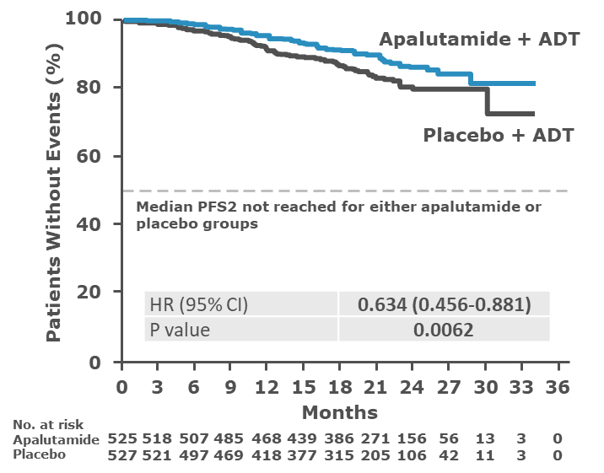
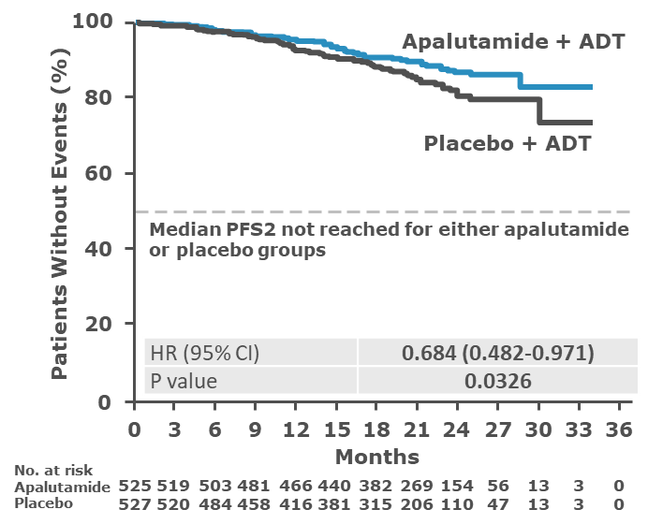
Discussion and Conclusion
In patients with mCRPC, germline or somatic HRR mutation testing will prove to be beneficial in the course of treatment.
A lot of patients receive enzalutamide post abiraterone or abiraterone post apalutamide. However, more data is required in terms of efficacy.
For this case, it will make sense to switch mode of action and go with docetaxel or cabazitaxel or Ra-223 or Lutitium-177, instead of hormone-hormone sequencing.
According to Kim Chi study¹, when the patient is treated with apalutamide upfront, there are less AR alterations. So, in theory abiraterone in sequence could make sense, but more clinical data is required for clarity.
Apalutamide results in risk reduction of secondary progression, regardless of choice for hormonal or taxane therapy.²
Upfront intensification is necessary with regards to better PFS and OS benefit of 14 months after therapy intensification.
PFS2: Hormonal Group²
PFS2: Taxane Group²
ADT: androgen-deprivation therapy; AR: androgen receptor; mCSPC: metastatic castration-resistant prostate cancer; OS: overall survival; PFS: progression-free survival, Ra-223: Raium-223
1. Chi K, et al. N Engl J Med. 2019;381:13–24. Chi K, et al. Poster #883P presented at ESMO 2019. 2. Agarwal N, et al. ASCO GU 2020.

Slide 6
THANK YOU!

