Slide 1
Managing adverse event reactions - Case A (Cutaneous reactions with Apalutamide)

Slide 2
Case details and discussion plan
Patient detailing
Discussion: How frequent would you monitor imaging test?
A case of 69-year-old gardener, Asymptomatic, fit individual enrolled in clinical trial NCT 03124433 was discussed. Additional parameters included:
PO Apalutamide 240 mg once daily
Week 3 reported truncal skin lesions that were no painful or pruritic
Progressed over 1 week to involve limbs
Topical steroids
OR
Anti-histamines
OR
Biopsy
Rashes within a month of using APA
After 1-2 weeks later to picture on right
OR
Cessation of APA for 2 weeks
APA: Apalutamide; PO: medication taken by mouth

Slide 3
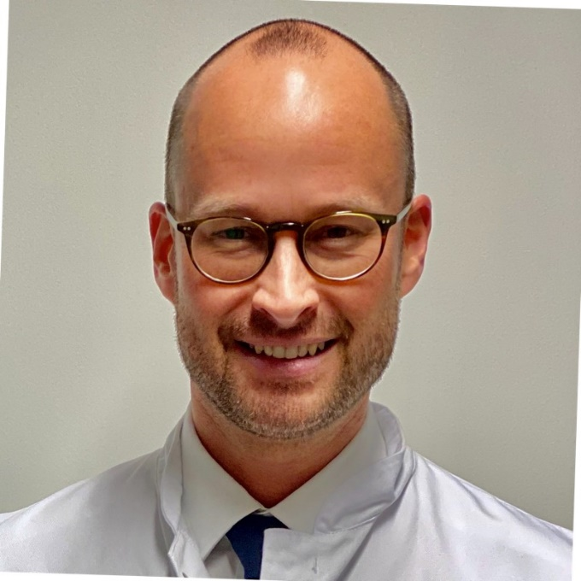
Panelist insights
Experts shared regional insights about rational management of this case and choice of treatment for such patients.
In my series of patients, there is hardly any rash observed.
In elderly patients, I start apalutamide with low doses, considering the risk of cognitive function impairment, and the dose is increased gradually. The patients never develop rash.
Therefore, this may be dose dependent.
The panelists agreed that:
This type of rash is generally not seen in patients undergoing treatment with apalutamide.
Goal should be to resolve the problem of rash and then restart the treatment.
Reduction in apalutamide dose may be an effective option.
Higher dose of oral corticosteroids is another option, which can be started at 1 mg/kg followed by dose reduction.
A/Prof. Edmund Chiong
This type of rashes are generally not seen for patients on apalutamide.
I personally have seen rash in a patient after 4-5 months, but even they were not this florid.
Dr. Loh Chit Sin
Reduction in apalutamide dose or higher dose of oral corticosteroid dose can be considered.
Corticosteroids can be started as high dose (1mg/kg) followed by weekly reduction in dose.
Also, a few local corticosteroids might help in majorly affected areas.
Primary goal would be to resolve and then restart again, washing out corticosteroids.
Prof. Axel S. Merseburger
A/Prof: Associate Professor

Slide 4
Conclusion
Reduce the dose or maybe start with mild corticosteroid.
High dose corticosteroid can be initiated, and the goal should be to resolve, and then restart again.
Patient preferred no treatment, and Apalutamide was stopped for 2 weeks.
Time taken was almost a month, but it resolved with no treatment.
Rechallenge at half dose and gradually increase.
Treatment approach by A/Prof. Lee Lui Shiong
Cessation of APA for 2 weeks
Total resolution over 2 weeks
Re-challenged: half dose at week 1, full-dose at week 2
No recurrence
APA: Apalutamide

Slide 5
THANK YOU!

