Slide 1
Managing Adverse Event Reactions - Case B

Slide 2
Case details and treatment approach
Patient detailing
Treatment approach by A/Prof. Lee Lui Shiong
This was a case of a 67-year-old Indian retired air crew having truncal maculopapular rash about week 4, limbs spared. The rash was not painful or pruritic.
Seven years from radical prostectomy – Gleason 9, T3aN1
Developed CRPC 5 years after radical prostectomy
Slow PSA velocity
PSMA at diagnosis of CRPC – enlarged left pelvic nodes just above bifurcation
Achieved nadir PSA with abiraterone for 12 months, thereafter, PSA doubling 5 months
Switched to APA
Declined chemotherapy
Truncal maculopapular rash about week 4, limbs spared
Rash was not painful or pruritic
No dosage modification
Resolved in 2 weeks
No recurrence
APA: apalutamide; CRPC: castrate-resistant prostate cancer; PSA: prostate-specific antigen

Slide 3
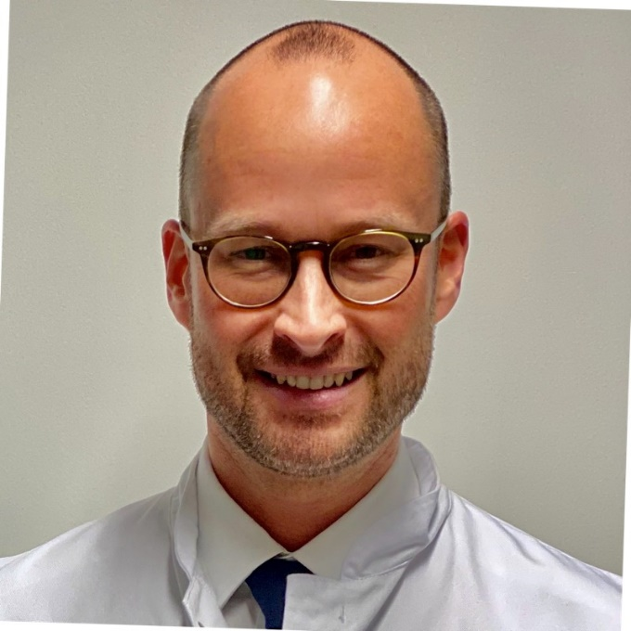
Panelist insights
Experts shared regional insights about rational management of this case and choice of treatment for such patients.
The first question that can be considered is whether this is a drug allergy or a known side effect because there is not much understanding on its mechanism.
The case has provided a lot of confidence. If I meet another case like this, to push on rather than to change therapy.
As it is not painful, so it gives confidence to stay calm and advice the patient that it's nothing serious.
A/Prof. Edmund Chiong
Dr. Loh Chit Sin
Prof. Axel S. Merseburger
Insights by A/Prof. Lee Lui Shiong
Stop Apalutamide if:
Rashes occur within first 1-2 doses
Histamine related skin lesions – pruritic, hives, angioedema
Type 1 hypersensitivity
In ‘typical skin rash’:
Treat symptoms
Dose modification or temporary cessation until rash improves or resolves
Re-dosing
Dose modification
Higher plasma apalutamide in Japanese patients with rashes
Skin AEs in APA studies:
SPARTAN – 23.8%
TITAN – 27.1%
Japanese patients – 51.5%
NEAR trial (NCT 03124433) – 30%
A/Prof: Associate Professor

Slide 4
Conclusion
A typical skin reaction may vary, it can be for a month or even 2-3 months.
Initial approach can be a symptomatic treatment.
Dose modification or temporary cessation must be done until rash improves or resolves.
Rechallenge rate is currently unknown, but on individual level, dose modification can be done at half dose.

Slide 5
THANK YOU!

