Slide 1
Low-volume mCSPC

Slide 2
Case details and treatment
Patient detailing
Patient treatment discussion
Patient was started on LHRH agonist + short term (3 weeks) Bicalutamide 50 mg used to prevent flare.
At 3 months → PSA: 26, testosterone: 0.49 nmol/L (<20ng/dl)
BMD T-score: - 4.0 (Osteoporosis)
Patient seen by dentist for clearance but had poor dentition with multiple dental decay – declined teeth extraction or denosumab
Calcium and vitamin D supplementation
Advised on light resistance and weight bearing exercise.
Started thinking if the patient requires intensification or not. Baseline studies revealed:
Baseline Creatinine and LFT was normal (ALP 71 U/L)
Baseline Thyroid screen – free T4: 12 pmol/L (normal); TSH 0.88 mIU/L (normal <4.5)
A case of 78-year-old male with no family history of prostate or breast cancer was discussed. The patient had well controlled hypertension and was urologically asymptomatic. Additional parameters included:
ECOG score: 0
Presented to vascular service for lower limb vascular insufficiency
CT abdominal-pelvis revealed: incidental multiple retroperitoneal and pelvic lymph nodes enlarged and no visceral metastasis
DRE: hard nodular prostate
Initial PSA: 147 ug/L
TRUS-Bx Gleason score: 4+5 = 9
CT scan showed 1 x L5 vertebral body sclerosis which led to suspicion of bone metastasis
Bone scan revealed no obvious metastasis
ALP: alkaline phosphatase; BMD: bone mineral density; CT: computed tomography; DRE: Digital Rectal Exam; ECOG: Eastern Cooperative Oncology Group; LFT: liver function tests; LHRH: luteinizing hormone releasing hormone; PSA: prostate-specific antigen; PSA: prostate-specific antigen; T4: thyroxine; TRUS-Bx: transrectal Ultrasound guided prostate biopsy; TSH: thyroid stimulating hormone

Slide 3
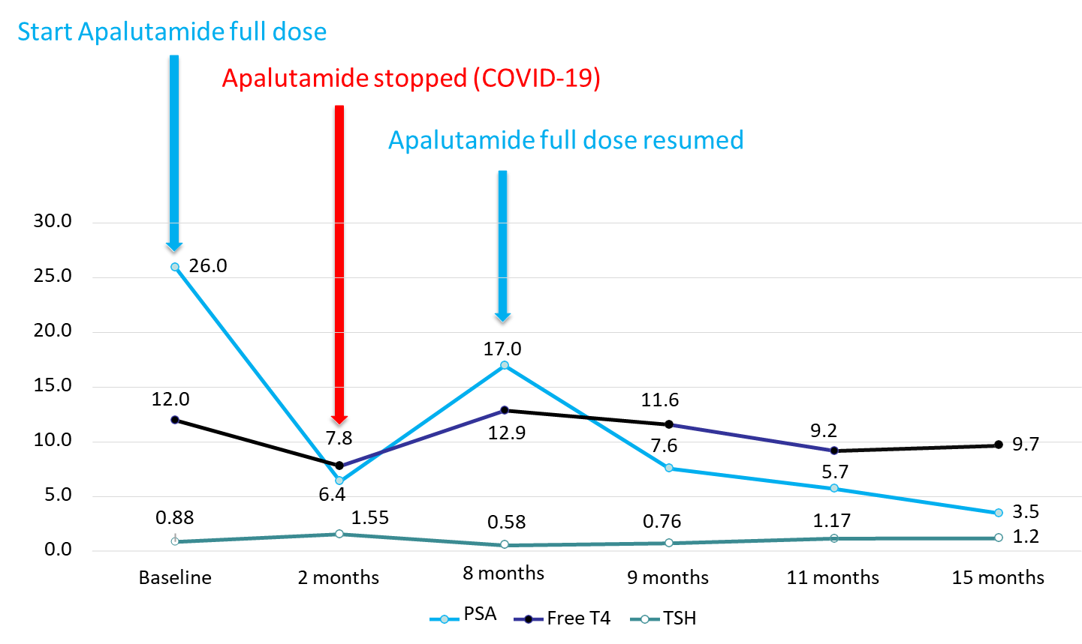
Case progression
After discussing treatment options, apalutamide was selected by the patient. Apalutamide was started at full dose 240 mg (4 tablets) daily. Two months later:
PSA dropped to 6.4 ug/L
Well, ECOG 0
Only felt some mild hot flushes
TFT: free T4: 7.8 pmol/L (slightly low; <8); TSH 1.55 mIU/L (normal; slight increase)
Apalutamide was stopped unexpectedly (no supply) on the 3rd month, as patient was stuck in neighboring country during COVID-19 lockdown. The patient could only continue LHRH-agonist. Apalutamide was resumed 5 months later:
PSA: 17 ug/L
free T4: 12.9 pmol/L (normal)
TSH 0.58 mIU/L (normal)
After 7 months,
PSA: continued to drop
TFT: normal
Figure: Dose vs timeline graph reporting PSA, free T4 and TSH levels through the treatment period
ECOG: Eastern Cooperative Oncology Group; PSA: prostate-specific antigen; TFT: thyroid function test; TSH: thyroid stimulating hormone; T4: thyroxine

Slide 4
Discussion plan
Patient imaging
Patient treatment
Patient post-progression treatment
Discussion 1: Would you consider additional imaging (Oligomets / low volume mCSPC on bone scan + CT TAP)?
Discussion 2: What would you do next (low volume mCRPC, after 3 months of ADT)?
Discussion 3: If patient progresses radiologically (bone and LN) after Apalutamide (mCRPC), what would you do next?
Add Docetaxel Chemotherapy x 6 cycles or Docetaxel Chemotherapy x 6 + Abiraterone
Whole body MRI
OR
Switch to Abiraterone + Prednisolone
OR
Add Novel hormonal therapy (Abiraterone + prednisolone/ Apalutamide / Enzalutamide) – which agent?
PSMA PET CT
OR
OR
Switch to Chemotherapy (Docetaxel / Cabazitaxel)
OR
Add RT to prostate
Choline PET CT / NaF PET CT / others
OR
OR
Add RT to prostate + RT to bone met (metastatic directed therapy)
Switch to Radium-223
OR
OR
OR
No further imaging
Add RT to prostate + RT to bone met (metastatic directed therapy) + Novel hormonal therapy
Other therapy eg. PARP inhibitor (genetic testing needed), Lutetium-PSMA therapy
OR
Continue ADT alone or Add older anti-androgen eg. Bicalutamide (Combined Androgen Blockade)
ADT: androgen-deprivation therapy; CT TAP: computed tomography of thorax, abdomen and pelvis; LN: lymph node; mCSPC: metastatic castration-resistant prostate cancer; MRI: magnetic resonance imaging; NaF: sodium fluoride; PARP: poly adenosine diphosphate-ribose polymerase; PET CT: positron emission tomography - computed tomography; PSMA: prostate-specific membrane antigen; RT: radiotherapy

Slide 5
Panelist insights – Discussion 1
Experts shared regional insights on consideration of additional imaging for such patients.
In Malaysia, PSMA PET CT scan is very cheap, cost as low as RM 3,200; therefore, many urologists are using it to stage the cancer before treatment.
Many patients who visit me for second opinion have been already staged using PSMA PET CT scan.
In my practice, I prefer conventional imaging before treatment.
A whole-body bone scan or abdomen to pelvic MRI scan or CT scan for nodular metastasis is also sufficient.
The panelists agreed that:
A thorough CT scan is sufficient to determine the staging of patients with mCRPC.
Prof. Axel believed “no further imaging” is a better option because the results will not vary as compared to PSMA PET CT (which will not decide the course of disease treatment).
PSMA PET CT for imaging is an option for patients whose are at high-risk and are eligible for surgery.
Panelists were not in favour of whole-body MRI and choline or NaF CT scan.
Dr. Loh Chit Sin
Properly done CT with contrast of the thorax and abdomen pelvis covering the entire axial skeleton + bone scan is quite adequate for staging.
PSMA PET scan is useful most of the times, except for 5-10% of patients having PSMA non-avid primary tumor, in which staging modality becomes useless.
I’m not in favor of wbMRI for two reasons → cost and resolution, the resolution is not as good as 3T MRI.
Also, not in favor of choline and NaF PET CT.
A/Prof. Lee Lui Shiong
In my practice, I would consider no further imaging.
If it is already known that patient has mPC and is being treated with ADT + APA/ENZA, then there is no point investing further in imaging, even if it is easily affordable.
Hence, if we know the case and imaging is already performed, then doing it again will not change the course of the disease and prolong OS.
PSMA PET CT is a better option for high-risk patients who may have to be operated, to check for cancer stage.
I’m not in favor of choline or NaF CT and wbMRI.
Prof. Axel S. Merseburger
A/Prof: Associate Professor; APA: Apalutamide; ENZA: Enzalutamide; mCRPC: metastatic castration-resistant prostate cancer; NaF: sodium fluoride; PET CT: positron emission tomography - computed tomography; PSMA: prostate-specific membrane antigen; wbMRI: whole-body magnetic resonance imaging

Slide 6
Panelist insights – Discussion 2
Experts shared regional insights on consideration of treatment for such patients.
For systemic therapy, I would not add much to this patient and would focus on metabolic outcomes because looking at the cardio-metabolic profile, the patient is obese.
We can surely start with abiraterone, along with prednisolone. But for this patient ADT alone might suffice.
I would also consider adding RT to primary and metastatic sites, for OS benefits
The panelists agreed that:
Hormone-hormone intensification treatment is a good option for patient with mCSPC.
ADT alone would not be sufficient treatment.
RT to primary and metastatic sites can also be considered.
The panelists were of the opinion that docetaxel may not be a good option for treatment.
A/Prof. Lee Lui Shiong
According to the CT report, I’m unsure about calling it as oligometastatic, because according to TNM, its already at M+ disease.
My recommendation would be in favor of therapy intensification with hormone-hormone combination because QoL remails along with OS benefits even in low-volume mHSPC.
Not sure about RT recommendation and also, would not give docetaxel because there is not much data from CHAARTED.
If bone pain symptoms are observed, I would recommend palliative RT because prostate RT can have side effects like proctitis or bowel voiding problems.
Prof. Axel S. Merseburger
A hormone-hormone intensified treatment combination will be a better option.
I would also prefer ADT alone for such elderly patient with oligometastatic disease, as he has given good response in 3 months.
I would consider this patient as high volume, since both iliac and aorta are affected.
Treatment with docetaxel will be of concern considering the patient’s age and RT as well is not a better option.
Dr. Loh Chit Sin
ADT: androgen-deprivation therapy; CT: computed tomography; mCRPC: metastatic castration-resistant prostate cancer; mHSPC: metastatic hormone-sensitive prostate cancer; OS: overall survival; RT: radiation therapy

Slide 7
Panelist insights – Discussion 2 cont…
Additional questions from A/Prof. Edmund Chiong
What is your opinion on definitions of disease volume quantification?
Does low-volume disease actually benefit from triple intensification as described in PEACE-1 study?
CHAARTED data is outdated for definition of high-risk patients, so we need to see individual patient specifically.
Here the patient is elderly, so the patient may not be the right candidate for docetaxel, so I would start with NHT and ADT combination and follow-up closely.
If this regimen fails, we can still give docetaxel as it is also approved to be given in second line and still works.
Treatment with docetaxel is not age-dependent, but considering QoL, this would be an ideal candidate for ADT and NHT.
PEACE-1 data is not full published and is a long running trial with a lot of changes in SOC.
Patients which are high-volume/high-risk, start with docetaxel and abiraterone can be considered as an add on treatment.
I don’t think we can conclude that this is better in low-volume disease.
Prof. Axel S. Merseburger
Prof. Axel S. Merseburger
I agree that current definition of high- vs low-volume disease has limitations and there is no marker beyond clinical indices to distinguish high vs low volume disease in precise manner.
For this patient, whose PSA response isn’t good, this would be indicative of imaging that can influence decision for monotherapy or even RT.
Few patients might be geriatric according to age, but functionally they might not be geriatric, and MDT assessment here can be very precise in terms of QoL, physical and mental status.
Patient can benefit from all the data, but if he doesn't have the social support or the physical physiology to tolerate, then it would not be a very fruitful outcome.
I agree with Prof. Axel and don’t think there is a clear head-to-head comparison between ADT + any oral agent or ADT + Abiraterone alone.
A/Prof. Lee Lui Shiong
A/Prof. Edmund Chiong
ADT: androgen-deprivation therapy; MDT: multi-disciplinary team; NHT: novel hormonal therapy; QoL: quality of life; RT: radiation therapy; SOC: standard of care

Slide 8
Panelist insights – Discussion 3
Experts shared regional insights on consideration patient progression after the patient chose Apalutamide as treatment.
The graph showed that when apalutamide was started after COVID-lockdown, the PSA level increased.
Therefore, baseline ADT is not enough, and therapy intensification makes sense.
Can GnRH antagonists can be considered for patients with very bad cardiovascular disease?
Prof. Axel S. Merseburger
A/Prof. Lee Lui Shiong
The patient did not have any significant cardiovascular issues.
Theoretically, if the patient did have ischemic heart disease, GnRH Antagonist eg. Degarelix is advisable.
I would consider the patient for chemotherapy, because if the patient is fit for chemotherapy, then the patient can be administered Lu-PSMA.
VISION study describes data with patients who already had chemotherapy.
A/Prof. Edmund Chiong
Dr. Loh Chit Sin
ADT: androgen-deprivation therapy; GnRH: gonadotropin-releasing hormone; PSA: prostate-specific antigen

Slide 9
Clinical insights
PFS2 does not actually compare sequencing with either 2nd novel hormonal therapy or subsequent chemotherapy to prolong overall PFS.
In PFS2, early treatment with effective therapy is better as compared to delayed effective therapy.
Interestingly in TITAN study, the frequency of AR aberrations detected at EOT was lower in patients who received APA + ADT than in those who received ADT alone.
Patients with detectable ctDNA or AR aberration at EOT had significantly shorter OS and PFS2 than patients without detectable ctDNA or AR aberration (TITAN study).
Acquired cross resistance to NHA treatment remains a clinical challenge - mechanisms driving resistance to AR axis agents may include upregulation of CYP-17A1, AR overexpression, or AR splice variants etc.
mCRPC options post-ARAT include:
Docetaxel (? TAX-327 trial)
Radium-223 (? ALSYMPCA trial)
Cabazitaxel (CARD study)
Olaparib (Profound study)
177Lu-PSMA-617 (VISION trial – post ARAT & ChemoRx)
Figure: Smith MR, et al. Poster presented at the 2018 American Association for Cancer Research Annual Meeting; April 14-18, 2018; Chicago, IL; Abstract 2605.
ADT: androgen-deprivation therapy; APA: Apalutamide; AR: androgen receptor; ARAT: androgen receptor axis-targeted; ctDNA: circulating tumor DNA; EOT: end of treatment; mCRPC: metastatic castration-resistant prostate cancer; NHA: novel hormonal agents; OS: overall survival

Slide 10
Discussion
CT scan is sufficient to determine the staging of patients with mCRPC, whereas PSMA PET CT can be considered for patients who are at high-risk and are eligible for surgery.
Hormone-hormone intensification treatment is a good option for patient with low-volume mCSPC in comparison to RT to prostate or Docetaxel.
PFS2 does not actually compare sequencing with either 2nd novel hormonal therapy or subsequent chemotherapy to prolong overall PFS.
In TITAN study,
the frequency of AR aberrations was lower in patients who received APA + ADT vs ADT alone.
patients with AR aberration at EOT had significantly shorter OS and PFS2 than patients without.
Acquired cross resistance to NHA treatment remains a clinical challenge.
ADT: androgen-deprivation therapy; APA: Apalutamide; AR: androgen receptor; CT: computed tomography; EOT: end of treatment; mCSPC: metastatic castration-resistant prostate cancer; NHA: novel hormonal agents; OS: overall survival; PFS: progression-free survival; PSMA PET-CT: prostate specific membrane antigen positron emission tomography - computed tomography

Slide 11
THANK YOU!

